Slide 1
Decoding Customer Sentiment : Analyzing
Amazon Fine Food Reviews with ML
UMBC Data Science Master Degree Capstone
Dr. Chaojie (Jay) Wang
Author Name: Gowtham Karaka, YM74533
GitHub Profile: https://github.com/gkk432/UMBC-DATA606-Capstone
LinkedIn Profile: https://www.linkedin.com/in/gowtham-karaka/

Slide 2
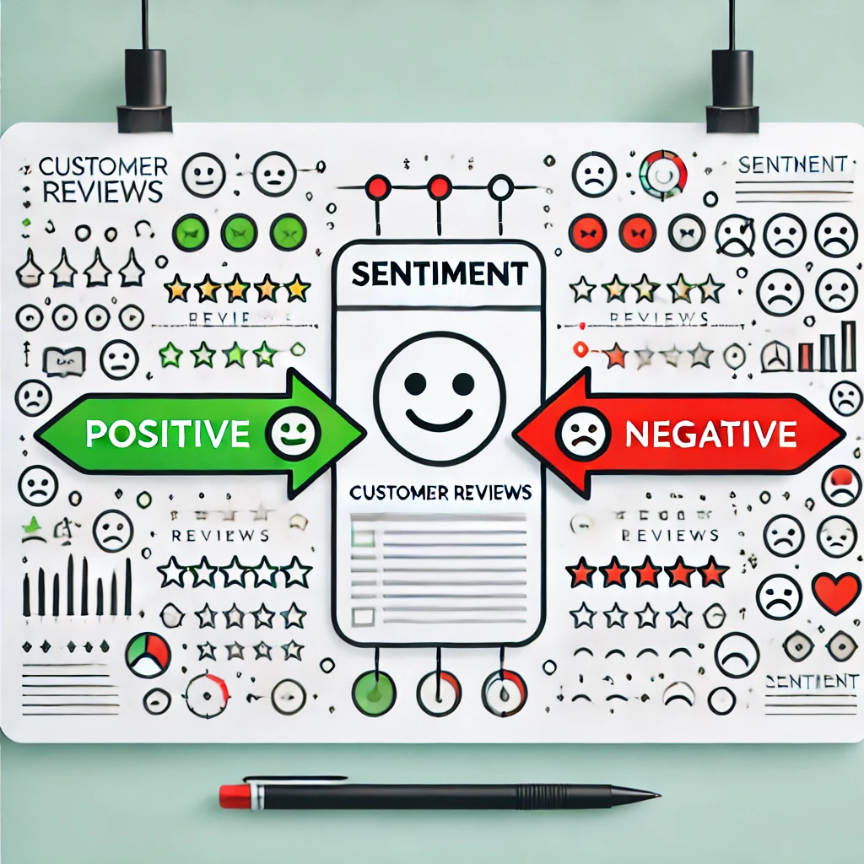
Introduction
In today’s digital age, the vast amount of user-generated content on platforms like Amazon provides valuable insights into consumer preferences and opinions.
This project focuses on sentiment analysis of Amazon Fine Food Reviews, aiming to classify reviews as positive or negative based on the sentiments expressed within them.

Slide 3
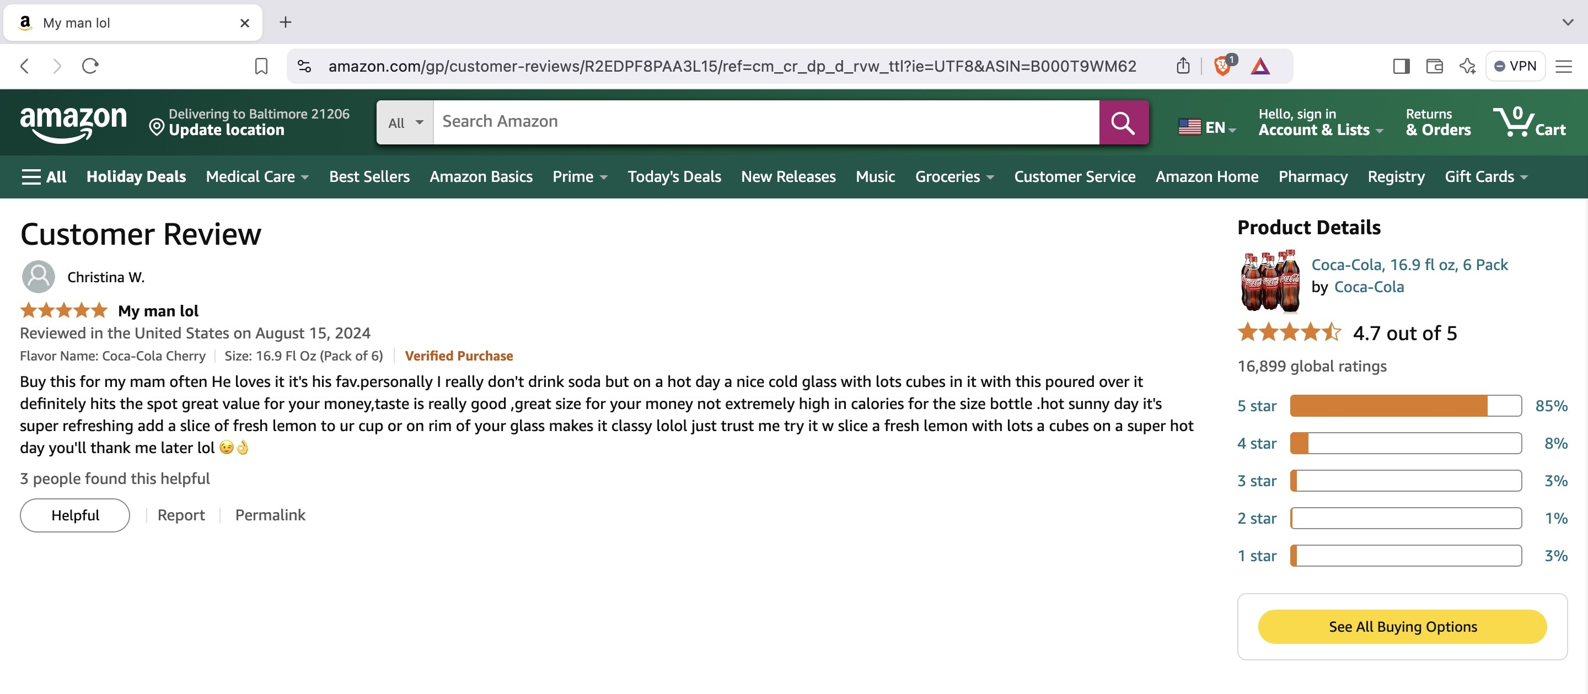
Dataset Overview

Slide 4
About the Data
Data sources: Amazon Fine Food Reviews dataset from SNAP and Kaggle.
Data size: Approximately 300 MB.
Data shape: 568,454 rows and 10 columns.
Time period: October 1999 to October 2012.
What does each row represent? Each row represents a single review of a fine food product on Amazon.
Which variable/column will be your target/label in your ML model?
Target variable for sentiment classification: Score (converted to binary sentiment: positive if ≥ 4, negative if ≤ 2)
Data dictionary:
Id: Integer - Unique identifier for the review.
ProductId: String - Unique identifier for the product.
UserId: String - Unique identifier for the user.
ProfileName: String - Name of the user.
HelpfulnessNumerator: Integer - Number of users who found the review helpful.
HelpfulnessDenominator: Integer - Number of users who indicated whether they found the review helpful or not.
Score: Integer - Rating between 1 and 5.
Time: Integer - Timestamp for the review.
Summary: String - Brief summary of the review.
Text: String - Text of the review.

Slide 5
Data Cleaning
Converting Score column to “Positive” or ”Negative”.
Handling Missing values.
Unix time stamp conversion.
Handling Data deduplication.
Correcting logical errors for ”Helpfulness Denominator/Numerator Column”.

Slide 6
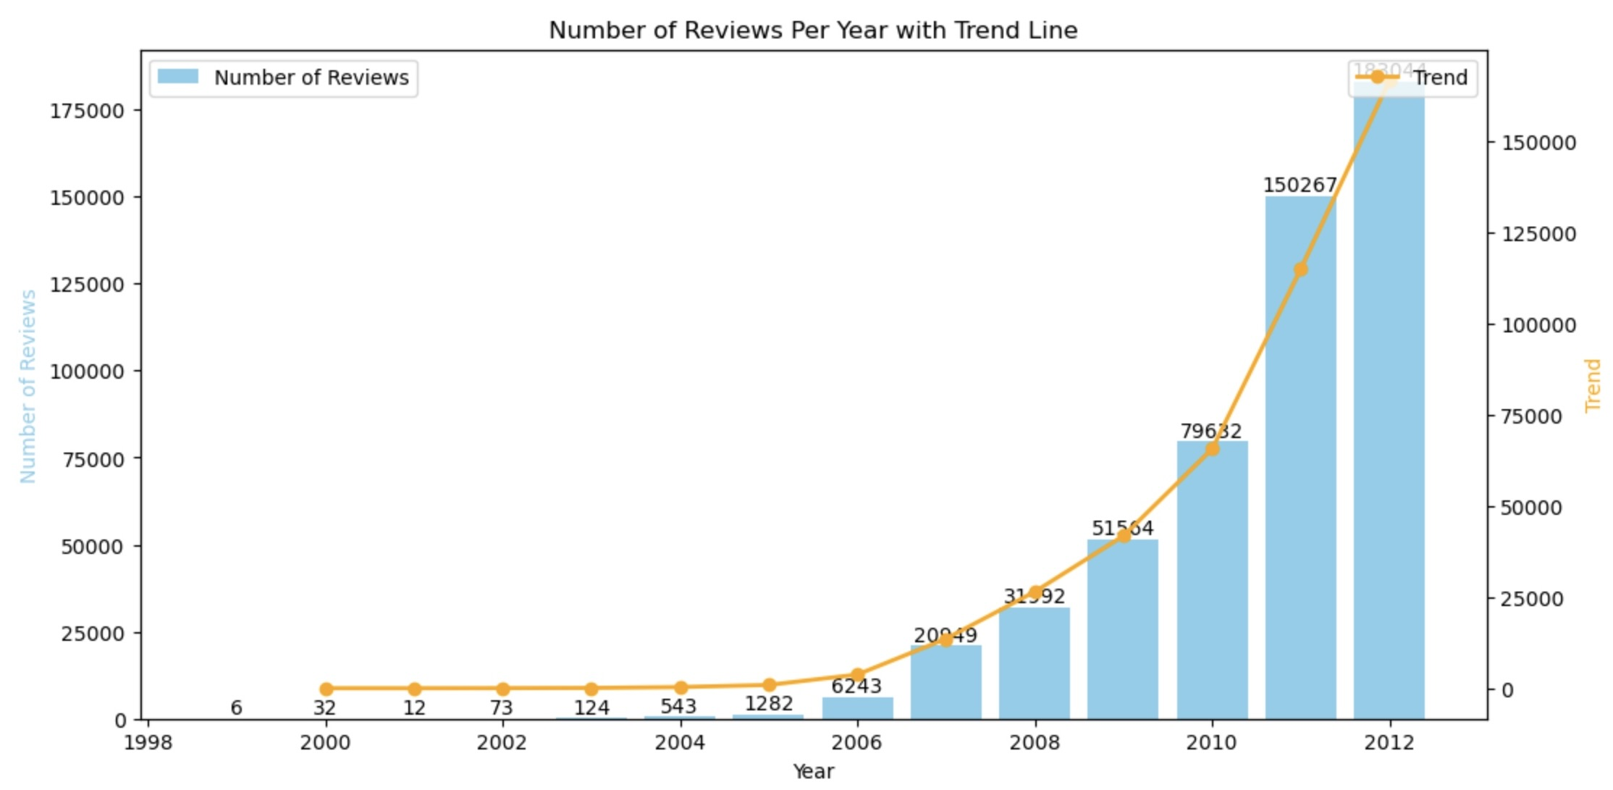
Exploratory Data Analysis

Slide 7
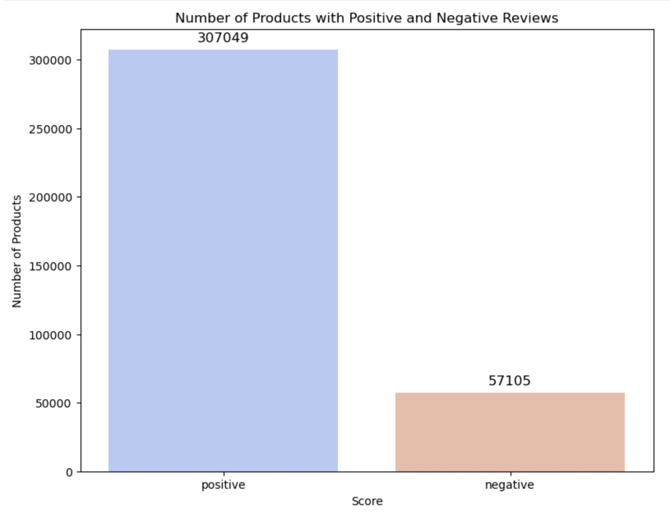
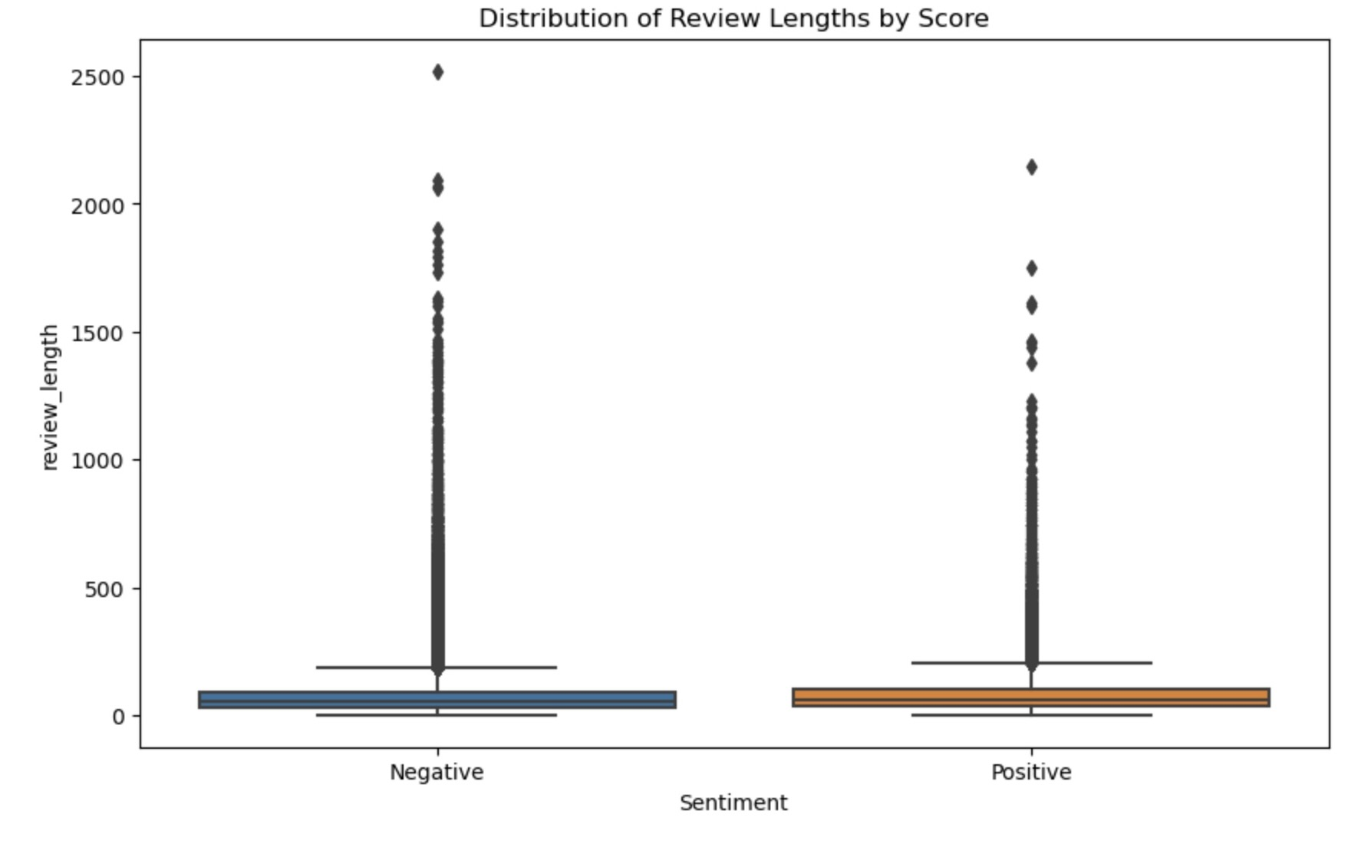

Slide 8
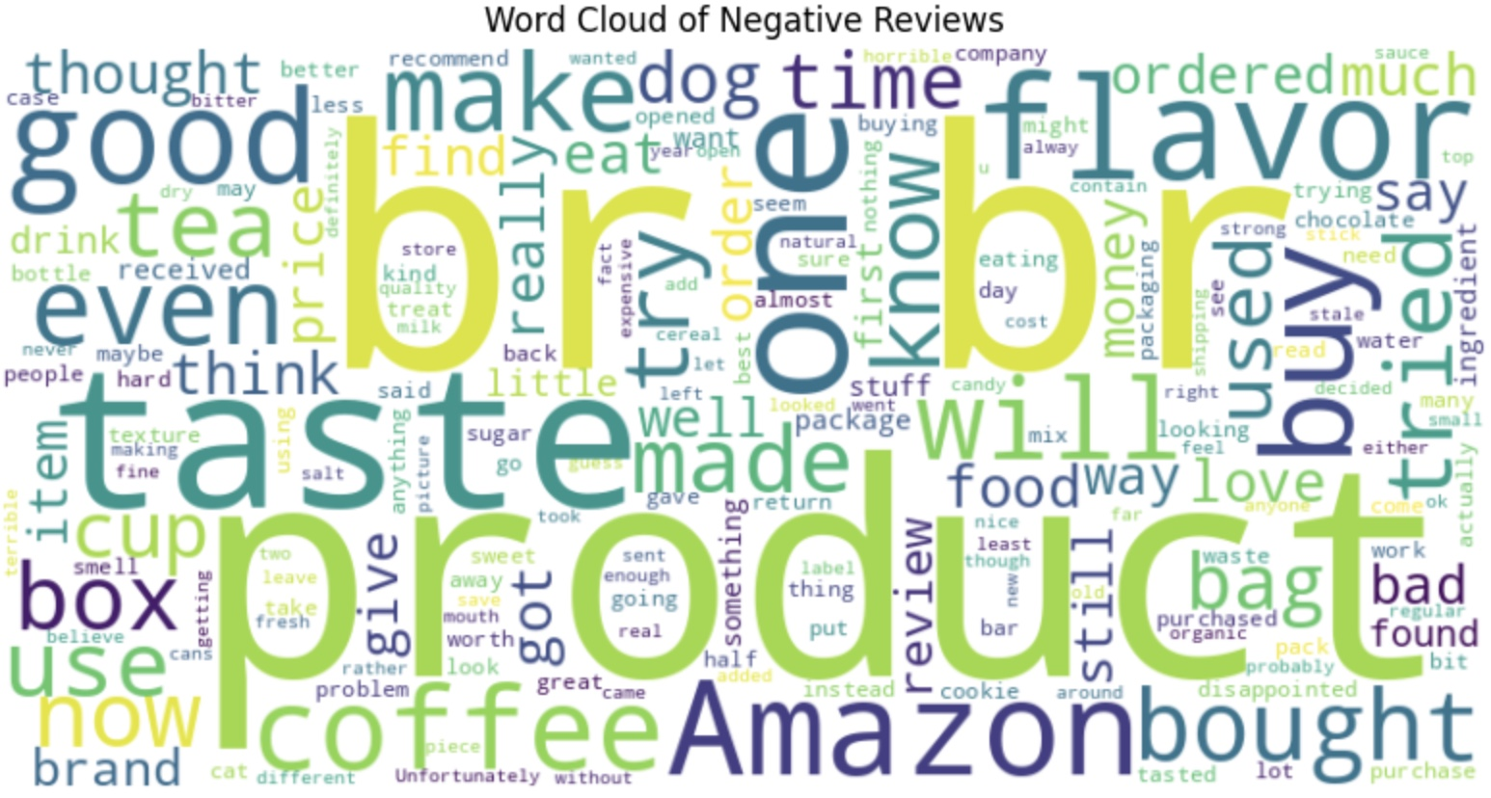
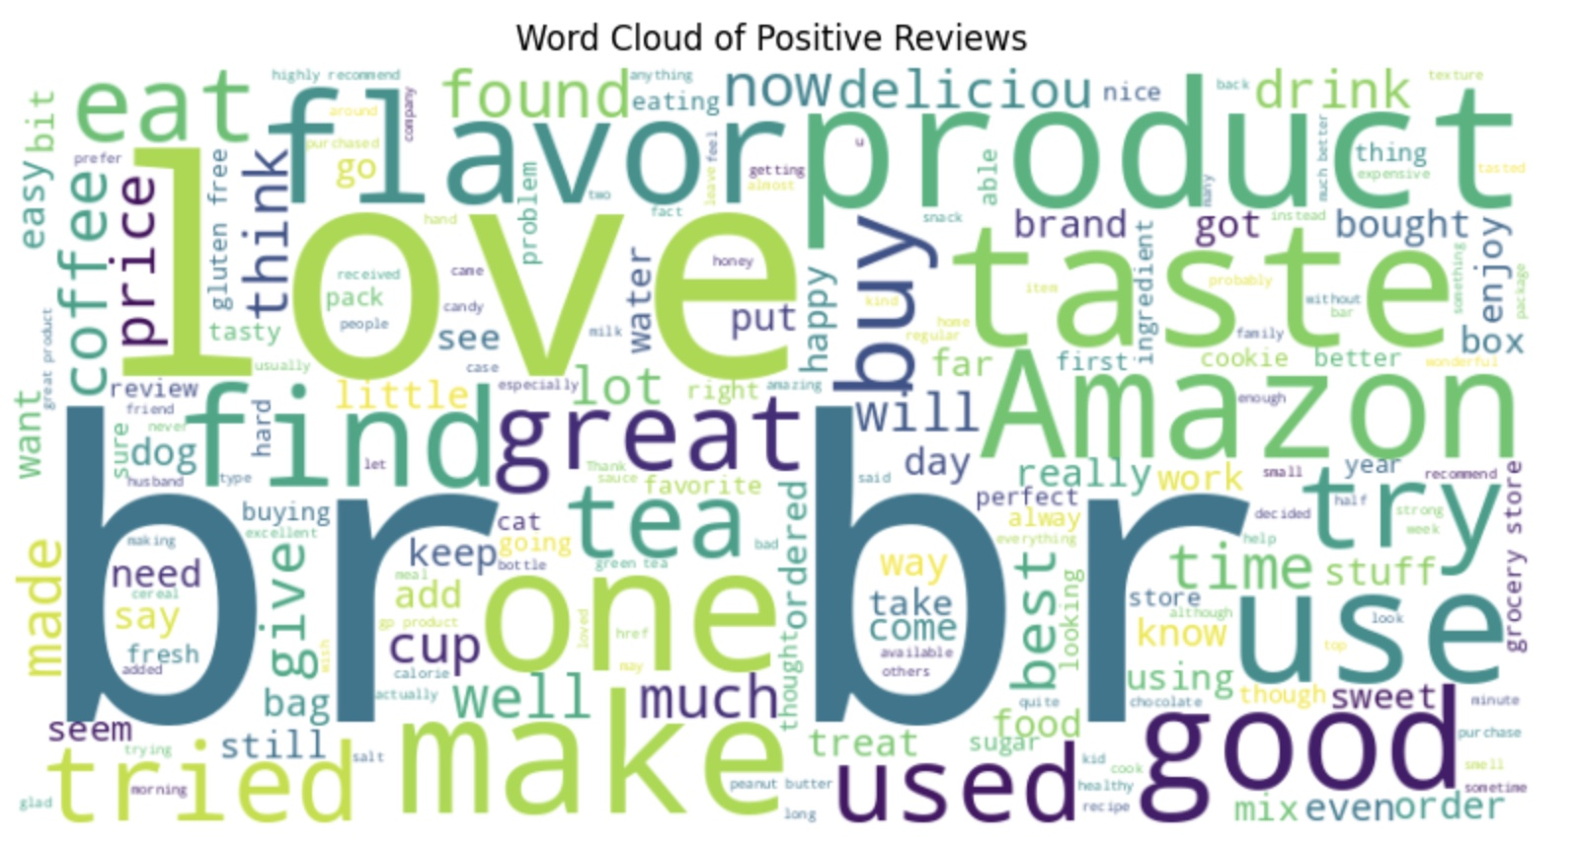
Word Cloud for Negative and Positive Reviews

Slide 9
Data Preprocessing
Converting to Lowercase
Removing Punctuation
Removing HTML tags
Tokenize and Remove Stop Words
Lemmatization

Slide 10
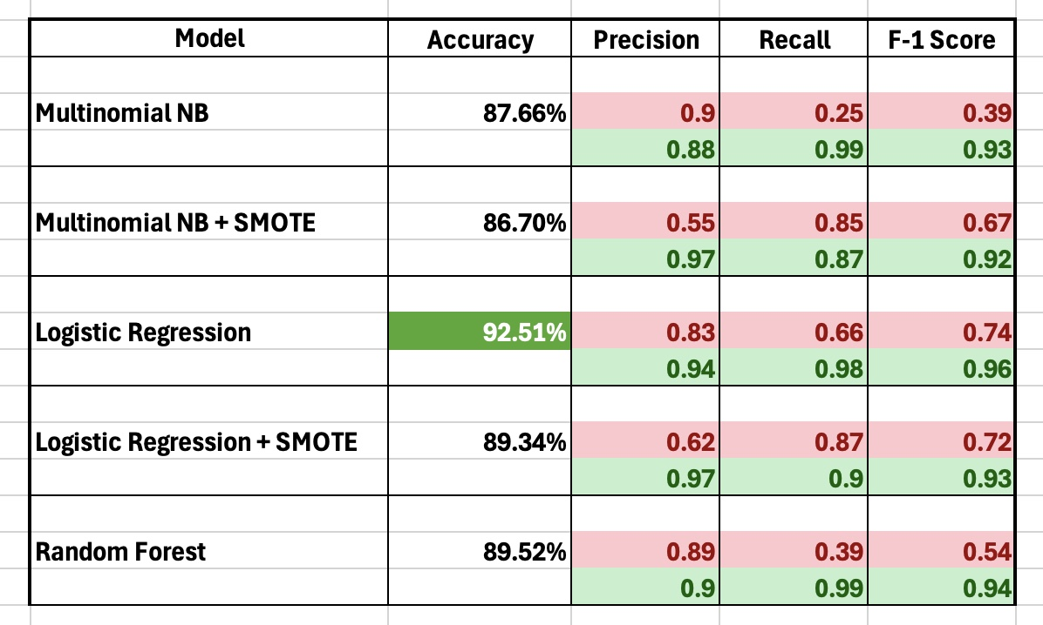
Model Selection

Slide 11
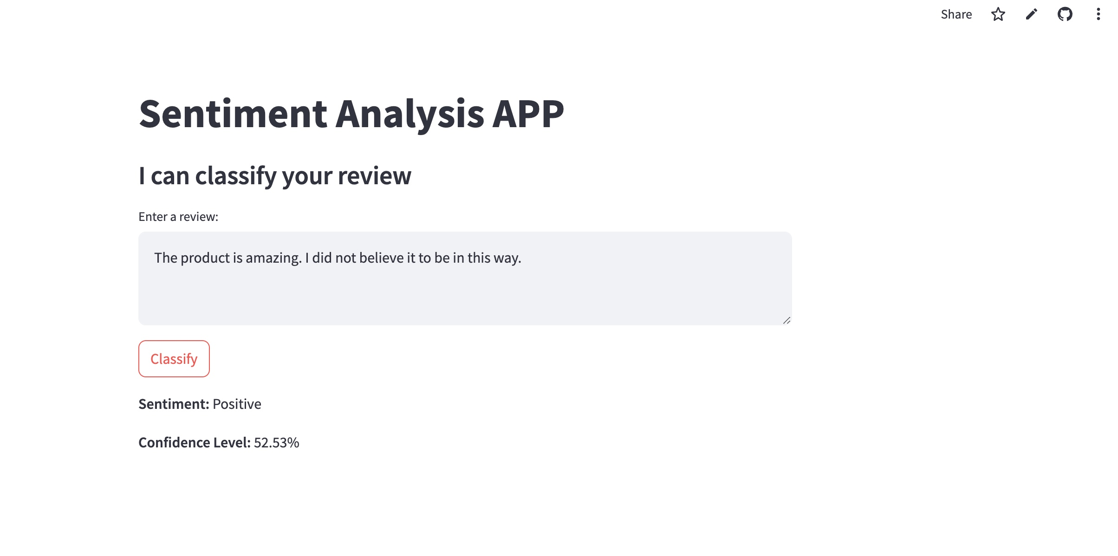
Streamlit Application

Slide 12
Summary
Project Overview
Key Findings
Potential Applications
Sentiment analysis on Amazon Fine Food Reviews to classify reviews as positive or negative with confidence. Utilizing various machine learning models, including Multinomial Naive Bayes, Logistic Regression, and Random Forest, we aimed to identify the most effective model for sentiment class
Logistic Regression emerged as the best-performing model with an accuracy of 93%, demonstrating strong performance on both positive and negative reviews.
The application of SMOTE improved recall for negative reviews but slightly decreased overall accuracy.
Business Insights
Market Research
Automated Review Classification

Slide 13
Limitations
Lessons Learned
Future Research Directions
Class Imbalance
Contextual Understanding
Generalizability
Importance of Data quality
Model Selection Matters
Iterative Improvement
Advance Models
Feature Engineering
Broader Applications

Slide 14
THANKYOU

